Slide 1
How to download NLDAS2 data
By Bennett McAfee, Patricia Tran, Hilary Dugan, and Robert Ladwig

Slide 2
1. Installing the right programs
Install wget. Tutorial: https://youtu.be/cvvcG1a7dOM?si=zmkcHz5SeWw1yqa9
Install R and Rstudio

Slide 3
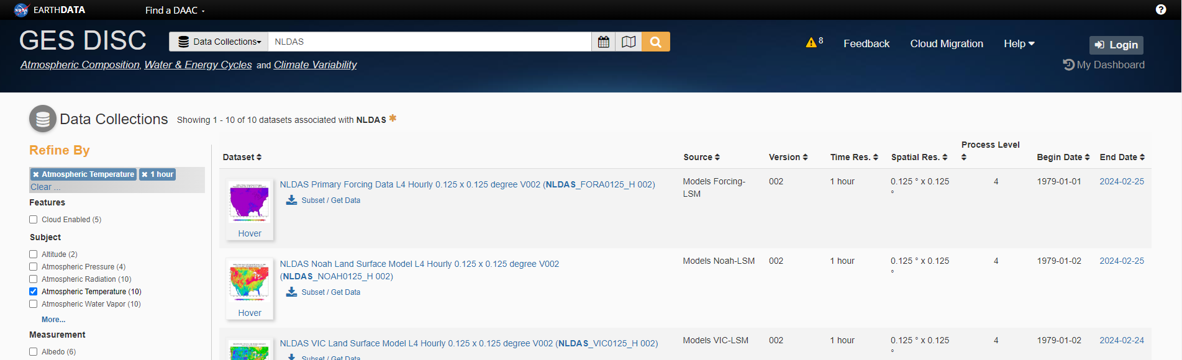
2. Get the list of URLs
Head to https://disc.gsfc.nasa.gov/datasets?keywords=NLDAS&page=1
If you do not have an account, click Login and make one. Then return to this page
Subset the search to your variables and timeframe of interest

Slide 4
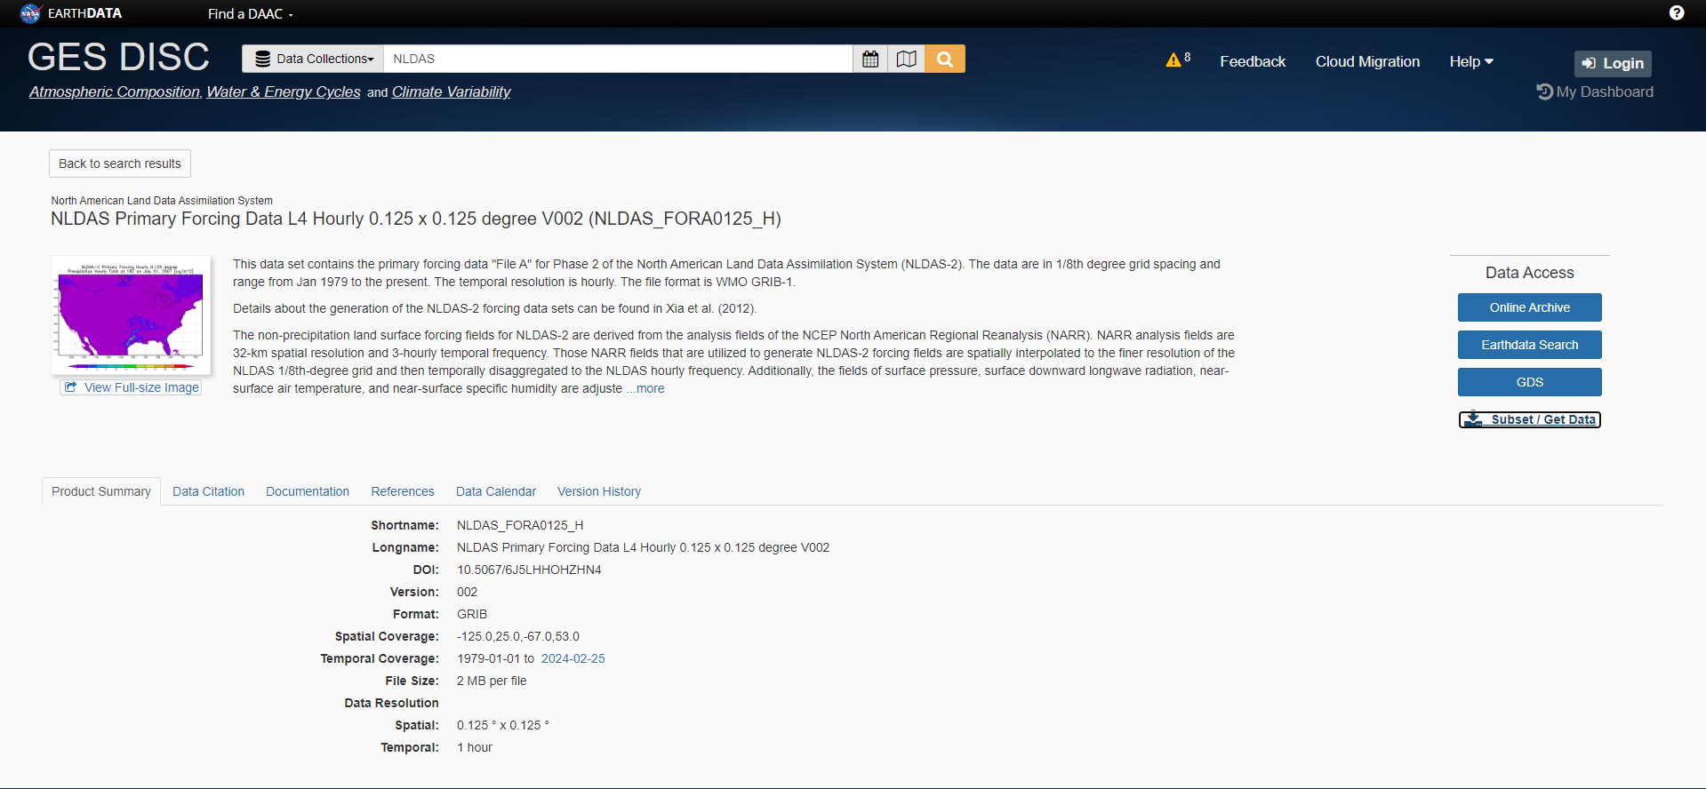
2. Get the list of URLs
Click on your data package of interest and then go to “Subset/Get Data”

Slide 5
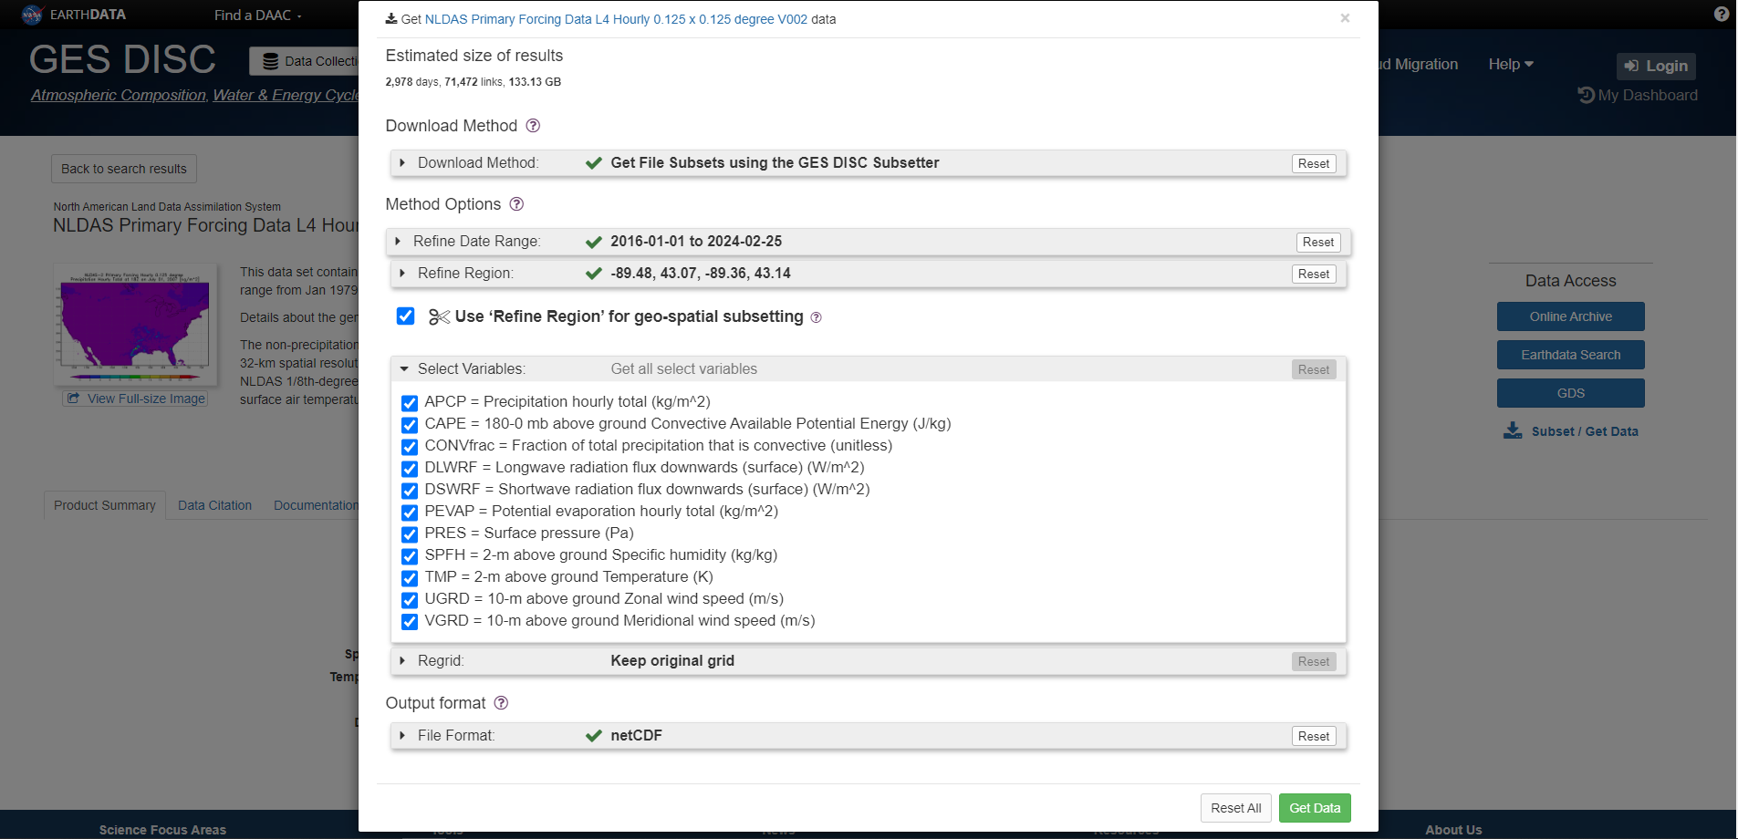
2. Get list of URLs
Select the settings below, adjusting your timeframe and geographic coverage as needed.

Slide 6
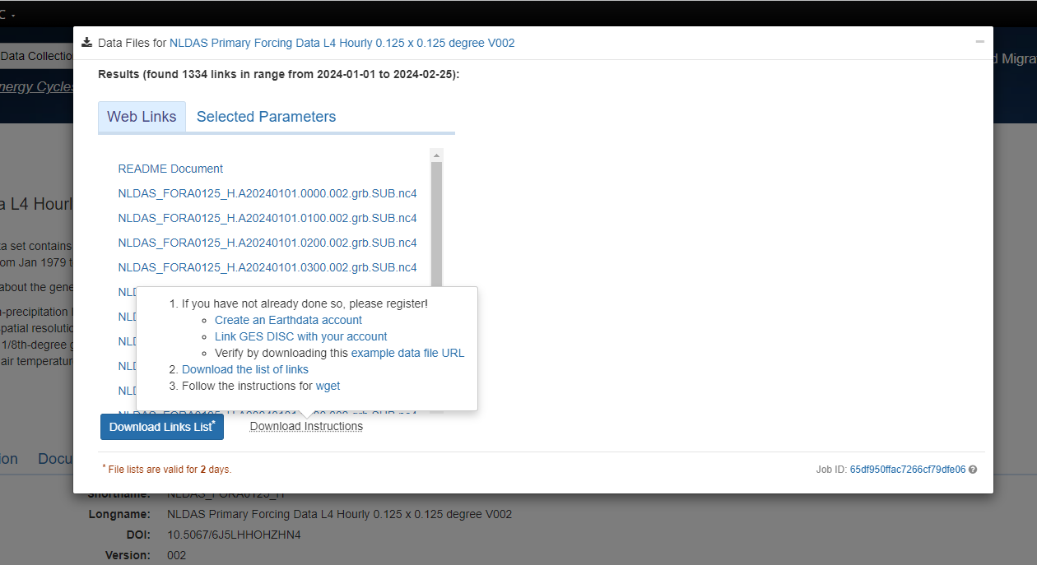
2. Get list of URLs
Follow the instructions in steps 1 and 2 of “download instructions” to set up your Earthdata account
Click ‘Download Links List’ to get the list of links. Store this list in your R directory

Slide 7
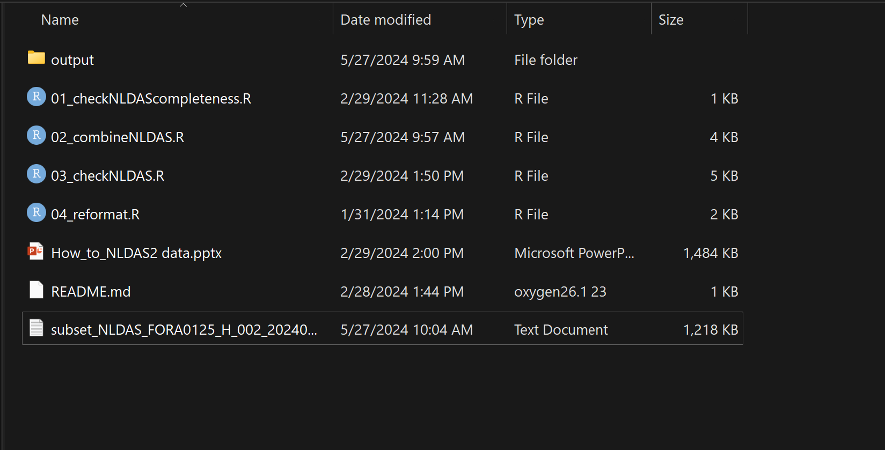
3. Save your list of links to your project the folder alongside your R scripts 3.1. Create a folder called ‘output’ in your directory if it does not already exist

Slide 8
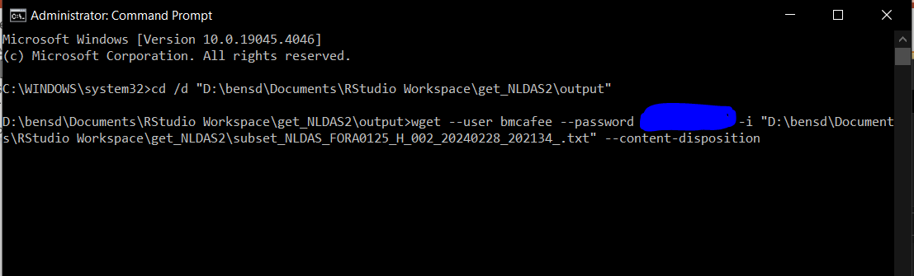
4. In the command prompt (run as administrator)
Change your directory to the output folder next to the R scripts
Run the following command:
wget --user [username] --password [password] -i [text_file_downloaded] --content-disposition
Note that this process may take several hours or days of uninterrupted internet connection. However, you can restart the process using the script from step 5.

Slide 9
5. wget will retrieve most of the files, but many downloads will fail.
Edit line 6 of 01_checkNLDAScompleteness.R to point to your list of links
Run 01_checkNLDAScompleteness.R
Check todownload.txt to make sure it includes the files that failed to download

Slide 10
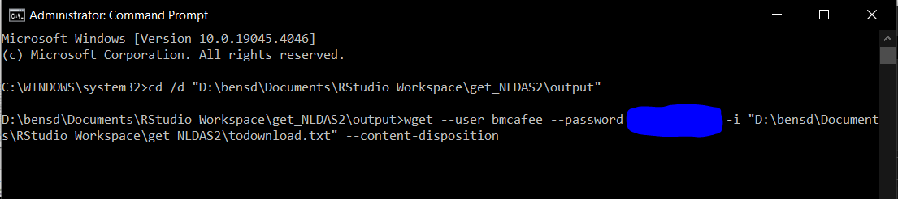
6. Run wget again, but pointing to todownload.txt
In command prompt, change your directory to the output folder next to the R scripts
Run the following command:
wget --user [username] --password [password] -i [todownload.txt] --content-disposition

Slide 11
7. Repeat steps 5 and 6 until there are no missing files. This may take many repetitions.

Slide 12
8. Run 02_combineNLDAS.R
Be sure to set the
lake name (line 23)
timeframe (line 25)
Number of cells (line 40) (if known)

Slide 13
9. Run 03_checkNLDAS.R
Be sure to set the
Lake name (line 5) (same as 02_combineNLDAS.R)
Lake time zone (line 6)
Number of cells (line 7) (if known, same as 02_combineNLDAS.R)
Timeframe (line 9) (same as 02_combineNLDAS.R)

Slide 14
10. Your final files will be in the [Lakename]_Final folder
The file name will have “all_variables” followed by either GMT or the local time of the lake.

Slide 15
11. Optional: Reformat for use with 1D-AEMpy
Immediately after running 03_checkNLDAS.R (do not clear the R environment) run 04_reformat.R. This will rename the variables for compatibility with 1D-AEMpy.

